Slide 1

Object Detection Model using TensorFlow API
Name: Jitendra singh
Section: G
University roll number: 2014407

Slide 2

Table of Contents
A General Framework for Object Detection
What is an API? Why do we need an API?
TensorFlow Object Detection API

Slide 3
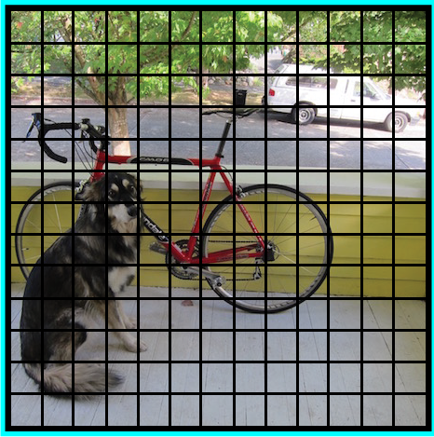
A General Framework for Object Detection
Typically, we follow three steps when building an object detection framework:
First, a deep learning model or algorithm is used to generate a large set of bounding boxes spanning the full image (that is, an object localization component)

Slide 4
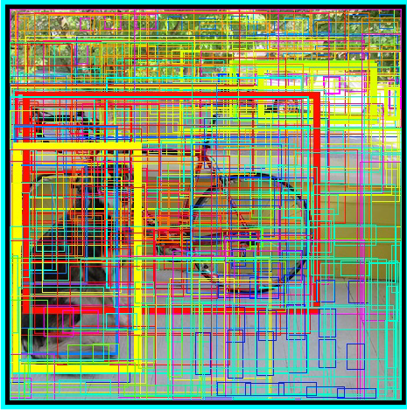
2. Next, visual features are extracted for each of the bounding boxes. They are evaluated and it is determined whether and which objects are present in the boxes based on visual features (i.e. an object classification component)

Slide 5
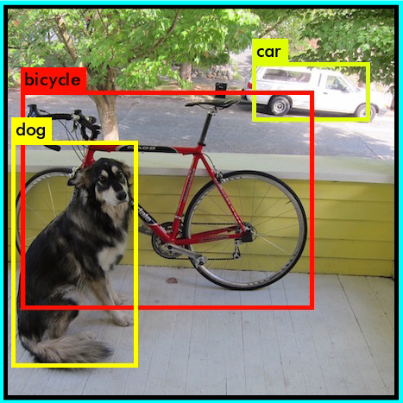
3. In the final post-processing step, overlapping boxes are combined into a single bounding box (that is, non-maximum suppression)

Slide 6
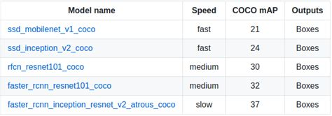
TensorFlow Object Detection API
1. The TensorFlow object detection API is the framework for creating a deep learning network that solves object detection problems.
2. There are already pretrained models in their framework which they refer to as Model Zoo. This includes a collection of pretrained models trained on the COCO dataset, the KITTI dataset, and the Open Images Dataset. These models can be used for inference if we are interested in categories only in this dataset.
3. They are also useful for initializing your models when training on the novel dataset. The various architectures used in the pretrained model are described in this table:

Slide 7
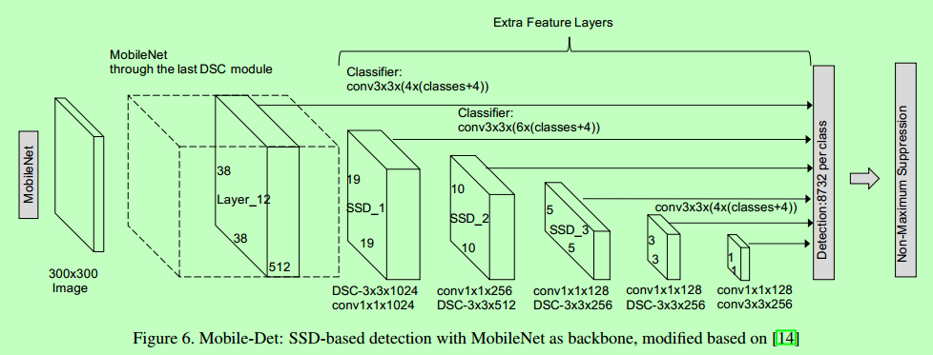
MobileNet-SSD
The SSD architecture is a single convolution network that learns to predict bounding box locations and classify these locations in one pass. Hence, SSD can be trained end-to-end. The SSD network consists of base architecture (MobileNet in this case) followed by several convolution layers:

Slide 8
SD operates on feature maps to detect the location of bounding boxes. Remember – a feature map is of the size Df * Df * M. For each feature map location, k bounding boxes are predicted. Each bounding box carries with it the following information:
4 corner bounding box offset locations (cx, cy, w, h)
C class probabilities (c1, c2, …cp)
SSD does not predict the shape of the box, rather just where the box is. The k bounding boxes each have a predetermined shape. The shapes are set prior to actual training. For example, in the figure above, there are 4 boxes, meaning k=4.

Slide 9

Import the Required Libraries
Import the object detection module
Model Preparation Loader
Loading label map
Object Detection Model using TensorFlow API
# What model to download.
Add a wrapper function to call the model and cleanup the outputs.
Run it on each test dataset and show the results.

Slide 10
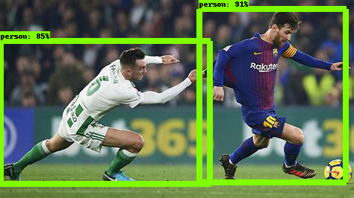
Output

